Slide 1
Your Agency Tech Stack The Good, The Better, & The Best
Catalyit LLC
Co-founder & CEO of Catalyit™

Slide 2
“
“It isn’t that entrepreneurs are smarter than companies, it’s that they are trying more crazy ideas, taking more shots on goal.”
“
Peter Diamandis, founder of the XPRIZE

Slide 3
The Risk Dilemma Cycle
Digitized
Deceptive
Disruptive
Dematerialize
Demonetize
Democratize
Notes:
Digitized: everything is becoming data
Deceptive: hard to see what’s coming and what impact it might have
Disruptive:
Dematerialize:
Demonetize:
Democratize:

Slide 4
The Risk Dilemma Cycle
Digitization: Virtually all information is being digitized
Deceptive: Early stage exponential growth hard to detect
Disruptive: “All of a sudden”
Dematerialization: Your SmartPhone
Demonetization: Craigslist for classified ads
Democratization: Goes anywhere and everywhere

Slide 5
Agency Tech Stack
A technology stack or tech stack for short refers to a set of technologies, software, and tools that are used in the development and deployment of sites, apps, and other digital products.

Slide 6

“Jeff, what does Day 2 look like?”
“Day 2 is stasis. Followed by irrelevance. Followed by excruciating, painful decline. Followed by death. And that is why it is always Day 1.”
- Bezos (2016 Letter)
Notes:
Principle #14
What does Day 2 look like?
“Day 2 is stasis. Followed by irrelevance. Followed by excruciating, painful decline. Followed by death. And that is why it is always Day 1.”
To be sure, this kind of decline would happen in extreme slow motion. An established company might harvest Day 2 for decades, but the final result would still come.
I’m interested in the question, how do you fend off Day 2? What are the techniques and tactics? How do you keep the vitality of Day 1, even inside a large organization?
As always, I attach a copy of our original 1997 letter. It remains Day 1.

Slide 7
“
Here’s a starter pack of essentials for Day 1 defense: customer
obsession, a skeptical view of proxies, the eager adoption of external trends, and high-velocity decision making.
“
Jeff Bezos 2016 Letter

Slide 8
Starter Pack of Essentials for Day 1 Defense
Customer Obsession
Skeptical view of proxies
Eagar adoption of external trends
High-velocity decision making

Slide 9
“
The outside world can push you into Day 2 if you won’t or can’t embrace powerful trends quickly. If you fight them, you’re probably fighting the future. Embrace them and you have a tailwind.
“
Jeff Bezos 2016 Letter

Slide 10
Discover
Trends
Solution Providers
Evaluate
Compare
Narrow
Select
Best Solution
Open Architecture
Implement
Goals
Change Management

Slide 11
The Shift to Remote
What have you learned?
What Process and procedures should change?
Communication & Collaboration is key
Flexibility is key
Rethink Your Assumptions
Notes:
I hope this email finds you well. As a small agency, we weathered the COVID-19 shift to remote work very well. Each employee has an identical workstation and office phone for their home office as well as printing & scanning capabilities. However, there is one area where we are deficient should the need arise to return to complete remote work. Our office has an old fashion analog fax machine. It works fine for incoming faxes as long as someone is in the building. We rarely send out going faxes now as that has been replaced by email.

Slide 12
Workplace Changes?
Death of the 5-day workweek?
01
Offices for comradery, not accountability
02
Employee flexibility is now table stakes
03
Notes:
4-day work week?

Slide 13
Trends in Agency Technology
Existing Agencies
A few are adopting a startup mindset
Experimenting with new ways of doing business
New agencies are not waiting
M&A is creating new agencies
Not everyone likes larger organizations
Technology tools are easier and cheaper
Traditional Vendors are responding, but slowly
And, it’s not always their fault

Slide 14
Agency Technology Stack
Good
Better
Best
Basic Agency Management system
Accounting system, if not in Agency Management System
Office 365 Business Premium
VOIP telephone system
Website
Social media presence
Zoom
Agency Management system
Quoting system integrated with Agency Management System
Website with landing pages*
Paid social media management*
E-signature*
Electronic Fax*
Registered email*
Marketing automation
Antivirus
Offsite Backup
Managed technology services
Managed cyber protection
Offsite and onsite backup
Full Agency Management system
Commercial lines quoting
Website chatbot
Paid social media management across all platforms
Sales management software
Video Production
Client Portal for service
Client Portal for quoting
Encrypted email

Slide 15
Agency Technology Stack - Good
Basic Agency Management system
Accounting system, if not in Agency Management System
Office 365 Business Premium
VOIP telephone system
Website
Social media presence
Zoom

Slide 16
The System Selection Process
Create a strategy
Establishing system requirements
Selecting your options
Vendor demonstrations
Making the decision

Slide 17
Agency Technology Stack – Better
Agency Management system
Quoting system integrated with Agency Management System
Website with landing pages*
Paid social media management*
E-signature*
Electronic Fax*
Registered email*
Marketing automation
Antivirus
Offsite Backup
Managed technology services
Managed cyber protection
Offsite and onsite backup

Slide 18
Overview of Electronic Insurance Transactions
Include
Electronic signature
Electronic notification
Electronic delivery
Other electronic transactions
Legal Basis
Federal E-SIGN Act
State’s version of the Uniform Electronic Transactions Act (UETA)
State regulations

Slide 19
E-Signature Benefits
Consumer
Agency
Changing Expectations
Better Experience
Saves Time
Anywhere
Anytime
Any device
Reduced Cost
Workflow improvement
Stronger security
Stronger E&O
Improved Client Satisfaction
Better Retention

Slide 20

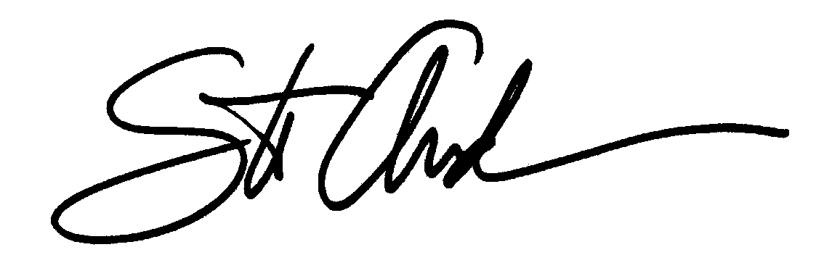
An Electronic Signature can be:
A Digitized Handwritten Signature...
The Typed Name of an Individual
Click “I Agree” button
A Secret Code or a Pin Number
An audio recording
Notes:
You hear the terms Electronic Signature and Digital Signature.
Let’s begin talking about the difference between an electronic signature and a digital signature.
An Electronic Signature can take on many different definitions. It could be
called a digitized handwritten signature like you see on your driver’s
license today.
Also it could be considered the typed name of an Individual. An example
is an email with your typed name at the end of the email.
In addition, a secret code or a PIN number has also been called an electronic signature.

Slide 21
A Digital Signature IS:
Technology Platform
A more secure way of signing electronic documents
Provides a High Level of Security
Virtually Impossible to Forge
Notes:
A digital signature on the other hand has certain advantages over electronic signatures.
A digital signature is a more secure way of signing electronic documents.
When a document is sent, there is a higher level of security, and it can be determined whether or not the document has been altered during transmission.
This is the primary difference between an electronic signature and digital signature.
Also it is virtually impossible to forge.

Slide 22
Agency Technology Stack – Best
Full Agency Management system
Commercial lines quoting
Website chatbot
Paid social media management across all platforms
Sales management software
Video Production
Client Portal for service
Client Portal for quoting
Encrypted email

Slide 23
Maximize Your AMS Investment
Build
a Digital Sales Culture
Create
Effective Workflows
Eliminate
Garbage In & Garbage Out
Update
Document Management
Master
PL & Cl Download
Focus on
Training
Upgrade
Client Communication

Slide 24
“
These big trends are not that hard to spot (they get talked and written about a lot), but they can be strangely hard
for large organizations to embrace. We’re in the middle of an obvious one right now: machine learning and
artificial intelligence.
“
Jeff Bezos 2016 Letter

Slide 25

Democratization of Machine Learning
Self Service Machine Learning Tools Becoming Common
Chatbots
BotStar
Tallyfy
EchoSage
Personal Example
Amazon Polly
Amazon Translate
Amazon Pollycast
Amazon Alexa Integration

Slide 26

Agency Data
Data Analytics is a pipe dream
Data quality
Consistency
Enforcement
Data first – Dashboards second
Create a culture of invention
Increase speed of adoption

Slide 27
InsurTech is Not a Dirty Word
Commercial Applications
Avyst
Indio (Acquired by Applied)
Broker Budda ($4.5 m Funding Round)
Distribution
Acrisure and Tulco Unveil Altway Insurance
direct-to-consumer brokerage platform which is fully supported by artificial intelligence.
“There remains a massive and unmet opportunity to truly create the broker of the future.”
Willis Towers Watson and Sompo Global Risk Solutions launch insurance platform for middle market commercial real estate companies (AON)
Risk Look Up (risklookup.com)
Bubbler – Home Insurance (Division of American Advantage – IA)
Quote+Apply – Sell Life Insurance Online (www.intelligentquote.com)

Slide 28
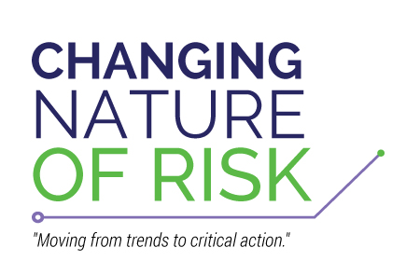

Slide 29
The Changing Nature of Risk Advisories
Artificial Reality/Augmented Reality/Mixed Reality - This is a quickly evolving trend that is in its infancy but has the potential to revolutionize the way insurance carriers and agents interact with their clients. Note: This topic does not cover Artificial Intelligence, which is partially covered under the separate topic of “Machine Learning”.
Autonomous / Crash-Avoidance Vehicles - Autonomous vehicles will significantly impact our personal interactions with vehicles and radically change both private-passenger auto and commercial vehicle insurance.
Virtualization - Virtualization (Automation) will impact the insurance industry by allowing agencies, carriers, and clients in other industries to automate certain tasks to reduce the resources - including energy, time, and labor - needed to do business.
Blockchain - Blockchain is one of the digital technologies starting to draw attention in the insurance industry, with consortiums like B3i charting use cases and structure.
Voice Computing - Voice Computing, also known as Conversational Computing and Voice Recognition, is the next major step in user interfaces.
3D Printing - 3D Printing will become more commonplace as price points reduce for the technology and as other industries embrace its usage.

Slide 30
The Changing Nature of Risk Advisories
Bitcoin, Crypto, and Virtual Currencies - Bitcoin and other crypto or virtual currencies have created alternative payment methods and alternative assets.
IoT (The Internet of Things) - The combining of technologies to solve problems which will eventually result in a connected world that few have imagined.
Work from Home - The culture of work is changing and how, when, and where we work is being redefined. New work models are emerging such as work from home and virtual freelance employees.
Cyber Liability - In the past 4-5 years the news of data breaches, hacks, ransomware, phishing have been pervasive. The potential impact of data breaches to compromise agency business, as well as the trust of their clients and partners should not be understated.
Telematics - Telematics is the branch of information technology that deals with the long-distance transmission of computerized information. It is a general term that refers to any device that gathers and transmits data in real time.
Machine Learning – This will impact our distribution channel by providing a new way to communicate with business partners, prospects and clients.

Slide 31
The Changing Nature of Risk Advisories
Peer to Peer (P2P) - Peer-to-peer (also referred to as ‘P2P’) Entities with commonality have been banding together to defray their risks financially for many years. The major differentiator in these new efforts is the innovative use of new technologies that improve the customer service, product distribution and deliver to reduce costs.
Smart Homes & Buildings - This technology has the potential of having a significant impact on underwriting, claims, and loss mitigation for property insurance in the near future.
Drones - As the number of UAVs and their useful applications increase, the exposures and insurance needs of consumers and businesses will increase.
The Sharing Economy - Insurance carriers are struggling to create best practices and products in a timely manner - agents are unsure of what questions to ask and are opening themselves up for E&O exposures, consumers are open to risk as they are unaware of exclusions on their policies.

Slide 32
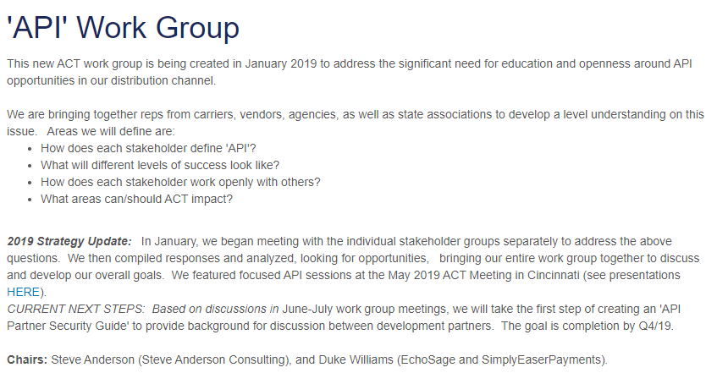
Agent’s Council for Technology

Slide 33

Chatbots
Capture staff knowledge, skills, and expertise
New way to answer client questions
Provide consistent — and correct — answers to common insurance questions.
Allows insurance agents to deliver their expertise to their clients more profitably.
Annual online automated account review
Frequently Answered Questions
Notes:
Consumer chatbot usage increased from 13% in 2019 to ~25% in 2020—almost double, according to research by chatbot maker Drift and Heinz Marketing. The bots are leveraged by retailers, banks, nonprofits, and more.

Slide 34
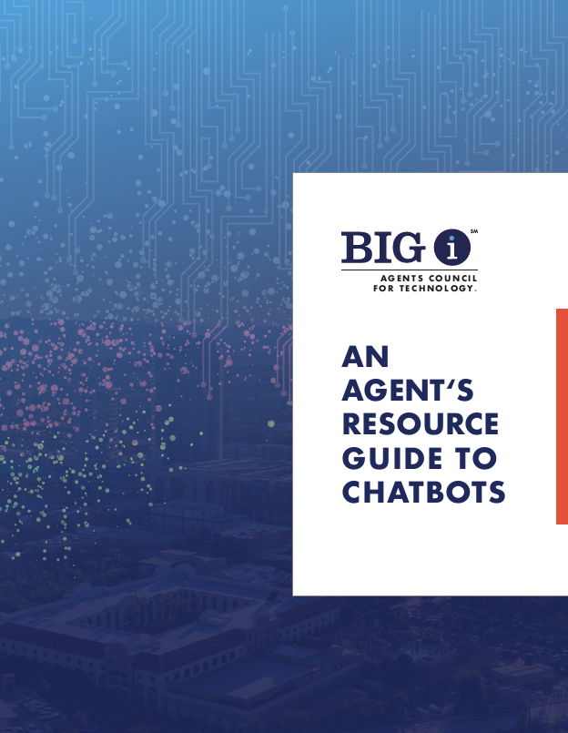
New ACT Resource GUide
CHATBOT OUTLINE
Executive Summary
Chatbot Overview
Current Uses in IA Distribution
Current Hurdles for Agent Implementation Agency Benefits
Agency Considerations
Strategic, and Before Purchase
Types of Chatbots
Features, Considerations, Selecting a Vendor
Resources, Additional Insights
https://www.IndependentAgent.com/ACT

Slide 35
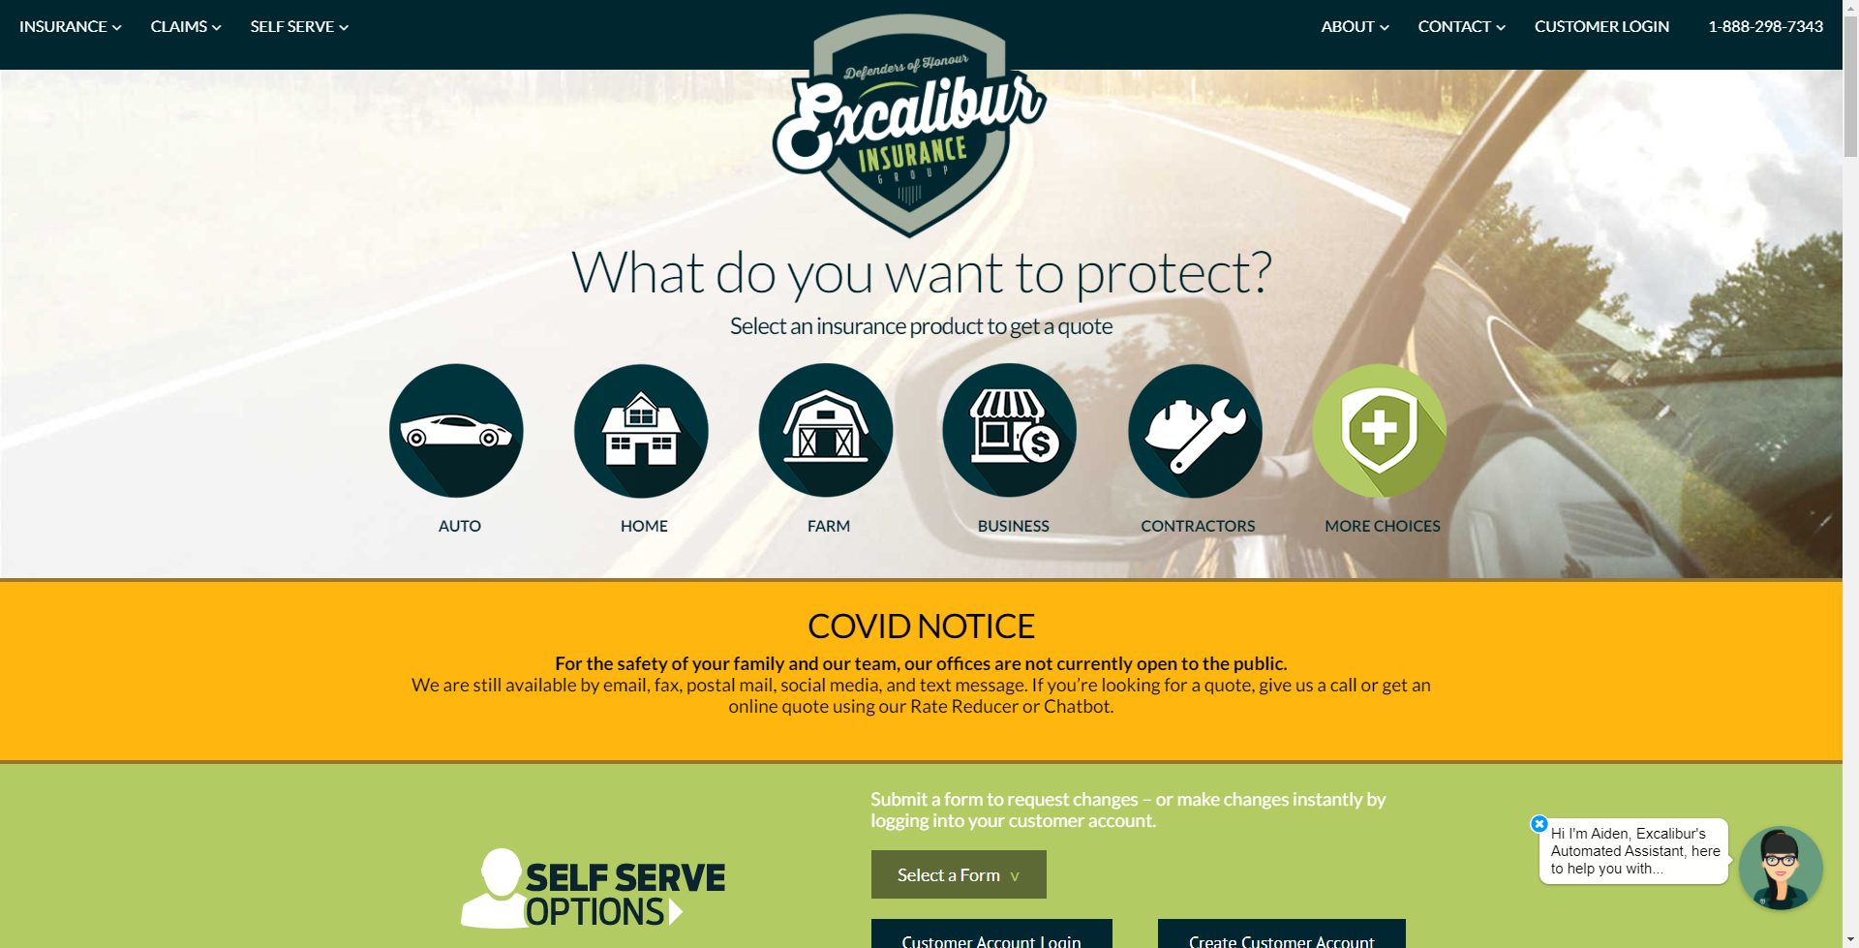

Slide 36
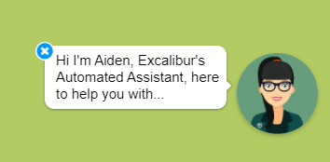

Slide 37
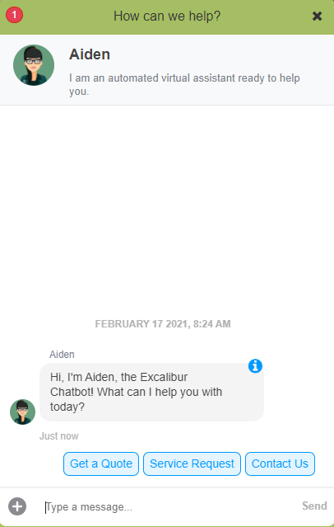

Slide 38
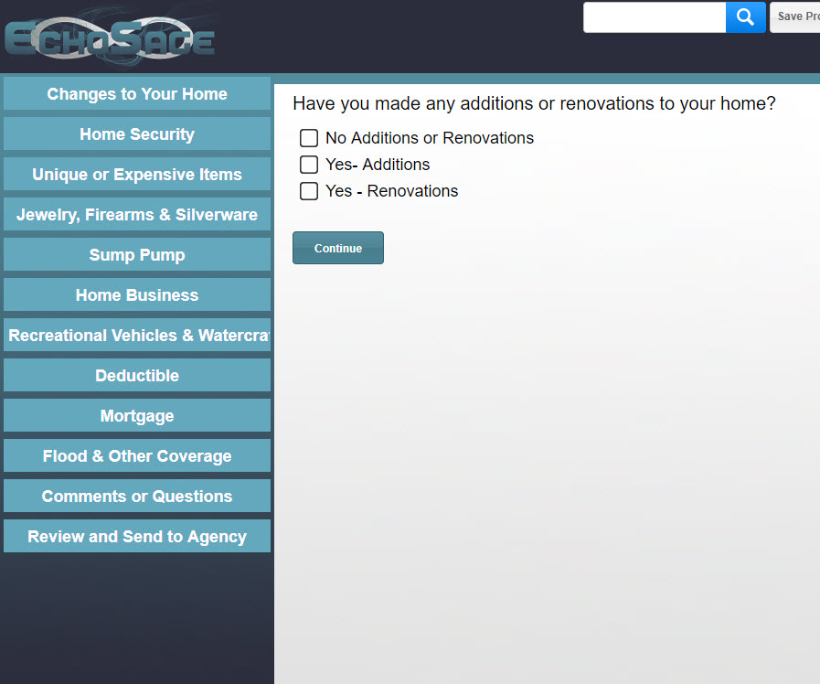
Automated Renewal Review

Slide 39
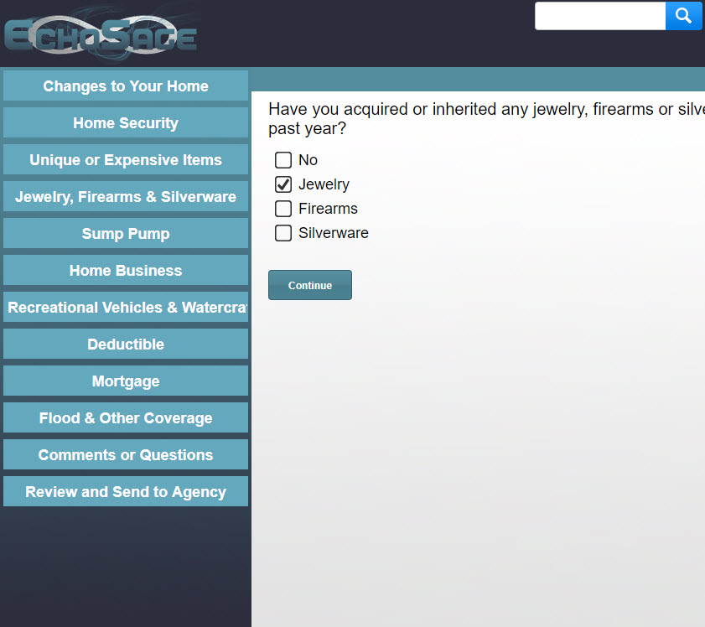
Automated Renewal Review

Slide 40
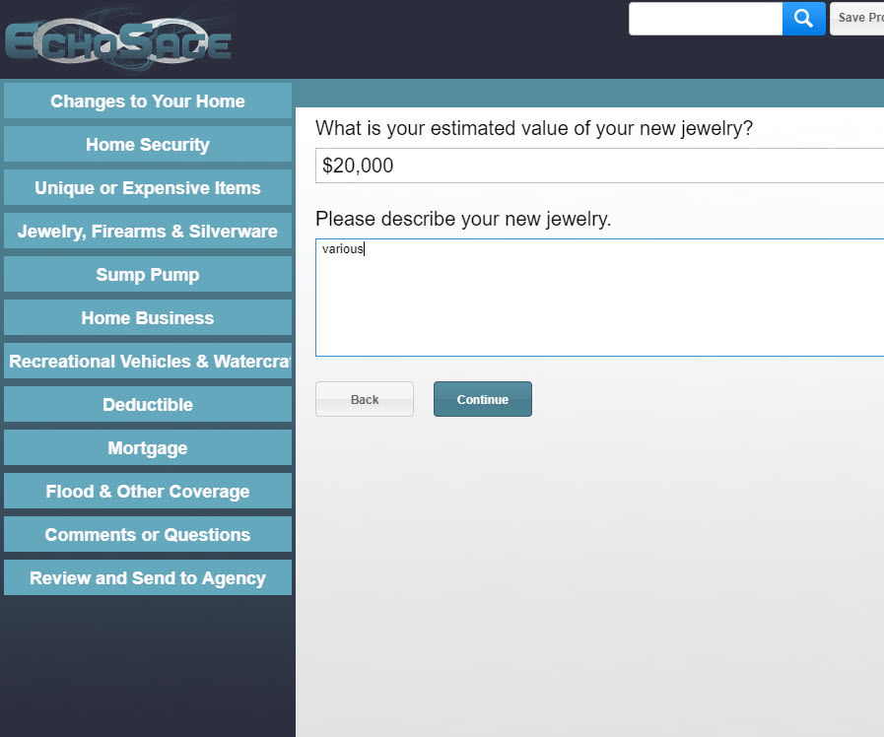
Automated Renewal Review

Slide 41
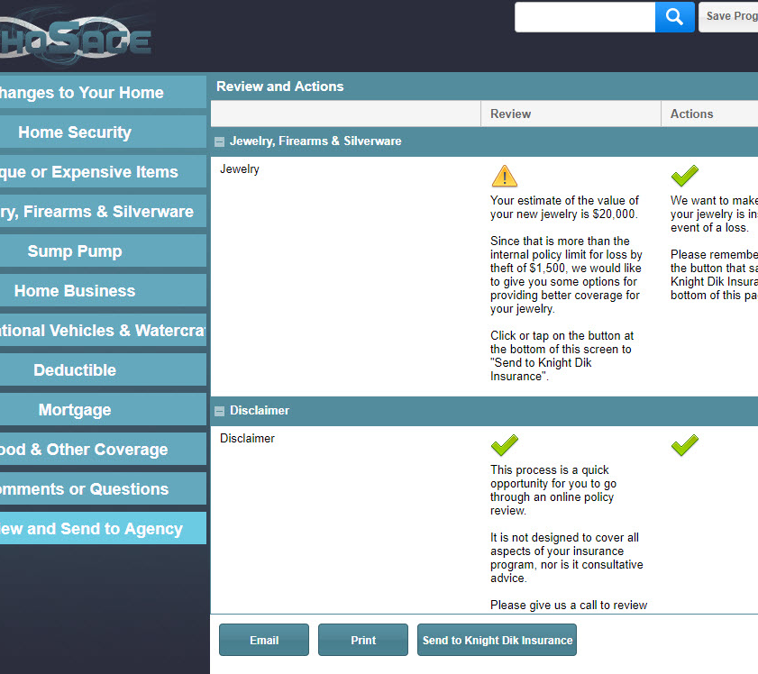
Automated Renewal Review

Slide 42
“
The outside world can push you into Day 2 if you won’t or can’t embrace powerful trends quickly. If you fight them, you’re probably fighting the future. Embrace them and you have a tailwind.
“
Jeff Bezos 2016 Letter

Slide 43
What Trends will You Embrace so you have a tailwind?
How will Your IT Department Help?

Slide 44
Technology is a Profit Center
IT is no longer an expense
Change Your P&L
Agency mindset shift needed

Slide 45
What Trends will You Embrace to have a tailwind?
How will Your IT Department Help?
Or, Will it hold you back?

Slide 46
What Trends will You Embrace to have a tailwind?
How will Your IT Department Help?
Or, Will is it holding you back?

Slide 47
Agency Technology Stack
Good
Better
Best
Basic Agency Management system
Accounting system, if not in Agency Management System
Office 365 Business Premium
VOIP telephone system
Website
Social media presence
Zoom
Agency Management system
Quoting system integrated with Agency Management System
Website with landing pages*
Paid social media management*
E-signature*
Electronic Fax*
Registered email*
Marketing automation
Antivirus
Offsite Backup
Managed technology services
Managed cyber protection
Offsite and onsite backup
Full Agency Management system
Commercial lines quoting
Website chatbot
Paid social media management across all platforms
Sales management software
Video Production
Client Portal for service
Client Portal for quoting
Encrypted email

Slide 49



LAUNCH Product & Services Overview
Core Product & Service Offerings:
Curated Community Platform
Agency Productivity Assessments
Customized Consulting

Slide 50


LAUNCH Product & Services Overview
Core Product & Service Offerings:
Training
Solution Provider Selection Tools
Access to the library of on-demand, virtual programs
Monthly live training events
Monthly group coaching (Virtual Live Q&A)
Subscription to TechTips
Marketplace of solution providers
Agency User Reviews
Unbiased, expert review on technology tools & platforms
Guide to choosing a solution provider

Slide 51
