Slide 1
Welcome To Insurance
Presented by:
Big I NY

Slide 2
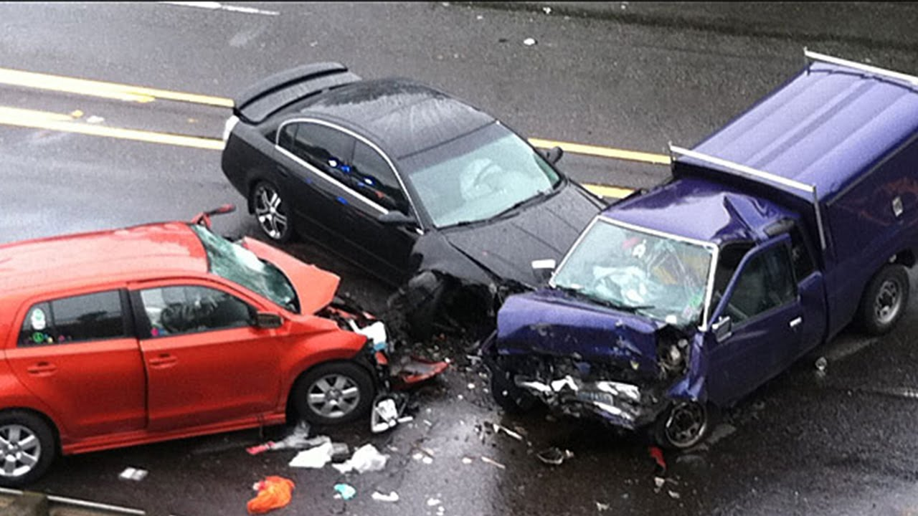

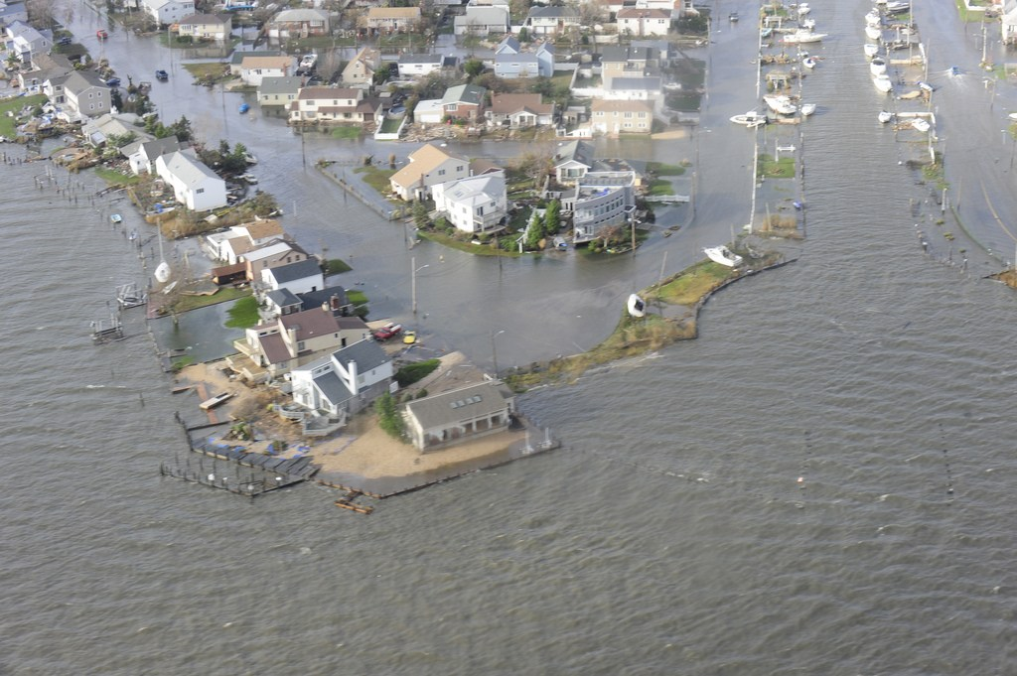
Insurance Is Fun!
-Insurance can be found in any community, business or family
-Not many people in other fields can say they truly make a difference in people’s lives when it matters most.
-The industry is always evolving so you are continuing to learn.

Slide 3
What does the Insurance Industry have to offer?
Opening job market
  The insurance industry employs about 2.6 million people.
  25% of the industry will be retiring in the next 3-5 years offering about 400,000 jobs across the county. And, oh, you don’t need a college degree in most cases!!
  60% of the people in the insurance industry are over 45 years old.
  Lots of opportunities for jobs in the industry.
Stable career
  The insurance industry doesn’t fluctuate like many other businesses.
  i.e. construction, banking, real estate, retail, luxury items, etc.
  There will always be a need for insurance despite the economic climate
  Deemed “ESSENTIAL” during Covid-19 Pandemic shutdown!

Slide 4



What does the Insurance Industry have to offer?
Can be a very lucrative career option.
Producers have no limited earning potential.
This means they can make as much as they want if they can sell. You control how much you make by setting your own sales goals.

Slide 5
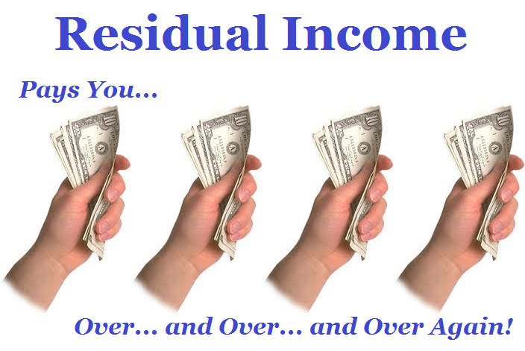
What does the Insurance Industry have to offer?
Sales are residual
  Most sales models rely on you selling a product every time to make commission
  If you sell a policy once, as long as it renews, you continue to get paid.

Slide 6
BUT IT DOESN’T HAVE TO BE SALES!! What else does the Insurance Industry have to offer?
There are many different types of jobs within the insurance community
  Attorneys
  Marketing, Graphic Design
  Actuaries – number crunchers who calculate risk patterns
  Construction/Restoration – build back homes after a loss
  Medical Professional
  Catastrophic Claims Adjustors – chase catastrophes (i.e. hurricanes)
  Customer Service Representative – help clients every day
You are exposed to many other business
  Need to learn about exposures your client many face, not all clients are the same.
  All businesses need insurance, you can focus on fields you like or find interesting.
  Everyday is different.

Slide 7
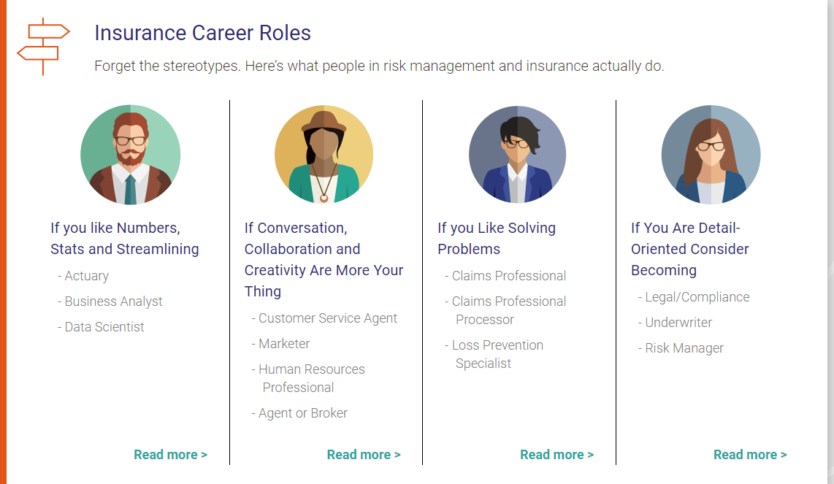
What does the Insurance Industry have to offer?

Slide 8
What does the Insurance Industry have to offer?
What do all those people do? Some of their jobs are specific only to insurance, while others can be found in almost any company, but have unique aspects when applied to the insurance field.
For instance, actuaries, underwriters, and claims adjusters are all roles and career paths that pretty much only exist in the insurance industry. Actuaries calculate probabilities of future events, underwriters determine what risks are worth insuring, and claims adjusters analyze losses to determine how much people or businesses are owed through their insurance policies.
On the other hand, data scientists, sales agents, marketers, customer service representatives and even risk managers work in all kinds of fields, but they play integral roles in making the insurance industry function.

Slide 9


Captive vs. Independent Agents
A captive agent works for only one company. For example, Allstate agents can only sell Allstate homeowners policies.
An independent agent represents many different insurance companies. For example, they could have 8 different companies that will write a homeowners policy.
Independent agents work for the client, not the company. It is easier to find the best coverage at the right price.

Slide 10

What does the Insurance Industry have to offer?
We cover your assets
  We protect our client’s homes, cars, business, etc.
  In the event of a loss we indemnify our clients to make them whole again.
  Workers Compensation, Liability, Disability Insurance all guard against physical injuries.
  We protect what is people value the most!!

Slide 11
Where can you study Insurance/Risk Management?
  St. John’s University-The Peter J. Tobin College of Business
  SUNY Oswego
  Utica University
  LeMoyne
  Saint Joseph’s College & SUNY Binghamton-Actuarial Science Degree
  SUNY Stony Brook University
  And many other colleges and universities
  You may also get your license right out of high school. No college degree needed!
    Pohs Institute
    Insurance Licensing Institute

Slide 12
Insurance Basics
How insurance works- It is a contract that transfers the risk of financial loss from an individual to an insurance company. The company collects small amounts of money from its clients and pools that money together to pay for losses.
Companies use the law of large numbers to estimate the losses. For example, an actuary looks at losses that have occurred in the past and predicts in the future 2 out of 100 policyholders will have a claim.
As the number of policyholders increases, the more confident the insurance company is its prediction will prove true.
Divided into 2 major categories: Property & Casualty and Life & Health.

Slide 13

Insurance Basics
What is an insurance policy?
  A contract between the insured (you) and carrier (insurance company) stating if a listed peril arises, the carrier will indemnify the insured in exchange for payment of the premium.
  Examples of perils are fire, wind, hail, flood, water damage, theft, etc…

Slide 14
Insurance Basics
Why is insurance important?
  Protect your assets
  Transfer risk (paying a carrier to take on the risk of a loss)
  Without insurance there would be no car loans or home/business mortgages.
  Work place injuries are covered by Workers Compensation.

Slide 15

Insurance Basics
Homeowners
  Covers the main structure
  Additional structures
  Contents
  Liability
  Additional expenses

Slide 16

Insurance Basics
Automobile (required by NY State)
  Liability (state minimums $25,000/$50,000)
  Uninsured/Underinsured Motorist Coverage – covers you if other party has no insurance or not enough insurance.
  Physical Damage (Comprehensive & Collision)
  What else can we insure?

Slide 17

Interesting Insurance Policies
Jennifer Lopez’s butt
  Insured for $27,000,000

Slide 18
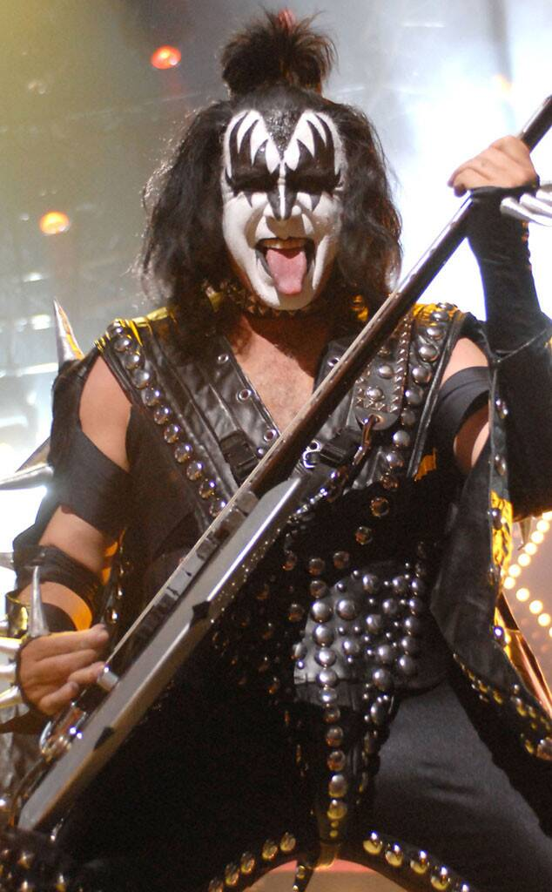
Interesting Insurance Policies
Gene Simmons, the bassist for the rock band, KISS,
insured his tongue for $1,000,000.

Slide 19

Interesting Insurance Policies
David Beckham career
  Insured for $195,000,000
  in the event of a career ending injury

Slide 20

How Does Insurance Affect You?
Purchasing your first car. You will need your own car insurance policy.
Renting an apartment you will need renters insurance. Covers your personal property in the apartment and liability.
Purchasing your first home. You will need homeowners and flood insurance.
Starting your own business. Some risks include the loss of property, liability to others, or loss of income when a loss occurs.

Slide 21
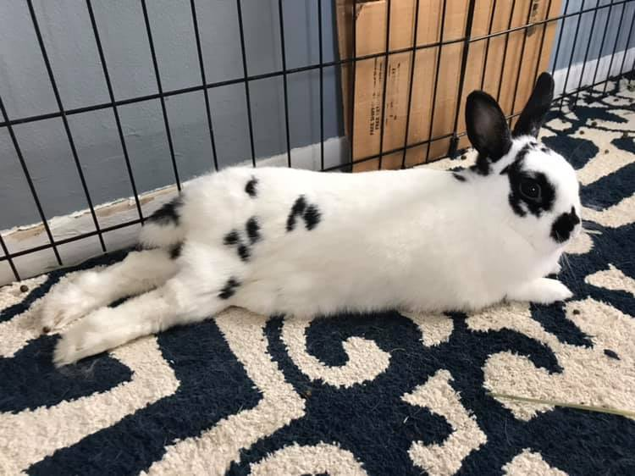
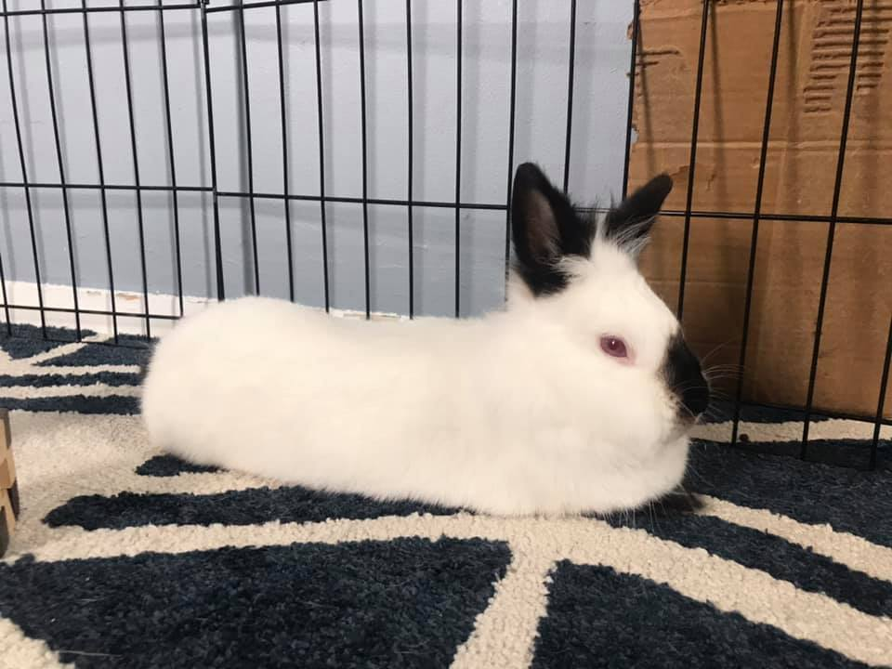
Interesting Insurance Policies
  Cyber Insurance- covers your business’ liability for a data breach involving sensitive customer information, such as Social Security numbers.
  Pet Insurance- healthcare policy for your pet that reimburses you for certain medical expenses.
  Key Person Life Insurance- life insurance on the key person in a business. If that person unexpectedly dies, the business receives the insurance payout.

Slide 22
Want to learn more?
Check out:
https://www.insuremycareer.com/
www.biginy.org
https://www.insuremypath.org/

Slide 23

Thank you for your time

