Slide 1

Your Introduction to Insurance
Presented By:
Big I NY

Slide 2
Table of Contents
What is Invest?
Why is Insurance important?
How can we help your students?
What education services do we provide?
Internship / Job Placement / Job Shadowing
Next Steps

Slide 3
What is Invest?
A non-profit organization dedicated to improving insurance literacy of students and attracting diverse new talent to the industry
Supported by over 500 insurance companies and organizations nationally
Our mission is to educate high-school and college students about the Insurance Industry and for those that are interested, offer internship, job placement and job shadowing opportunities

Slide 4
Why is Insurance important?
2.8 million people work in the insurance industry
More than 60% of insurance professionals will be retiring in the next ten years (over 1.2 million jobs)
Net premiums written for the US insurance industry in 2017 amounted to $1.2 trillion
Massive amounts of industry consolidation looking for new thought processes, strategies, technology and customer service

Slide 5
How can we help your students?
Guest speakers during an Invest class provide first-hand knowledge of what it’s like to work in the insurance field, and students have a new appreciation for the industry after hearing a professional speak.
Invest provides all the materials needed to speak in a classroom, including PowerPoint presentations, quizzes and discussion questions.
Topics can include ratings, claims, what to look for in a policy, how you have succeeded in the industry or specific insurance roles, like investigations and fraud.

Slide 6
What education services do we provide?
  Insurance 101
    Personal Lines vs Business Lines
    Property vs Casualty
    Employee Benefits
  Managing Risk
  What’s in a Personal Auto Policy
  How an Insurance Agency Operates
  How an Insurance Carrier Operates
  Marketing and Selling Insurance
  Real Life Examples of how Insurance affects us today
  Insurance Industry Job Outlook

Slide 7
Internship / Job Placement / Job Shadowing
Invest connects the world of Insurance Professionals with eager to learn students
Seasonal, Part-Time, Full-Time Internships and Jobs are available Nationwide
Not all students want to go to college. A career in insurance allows you to get involved in a stable, profitable and constantly evolving industry!
Our mantra is --whatever your passion, insurance has a career for you --

Slide 8
Next Steps
Send across any school-specific documentation we need to be presenters (if required)
Pair us with the applicable department(s) and teachers to set-up the presentation
  We see strong synergy with the Business / Finance or Guidance Department
Finalize the presentation and schedule
Deliver
Provide resources and a path for students who want to learn more!
References and testimonials are available

Slide 9
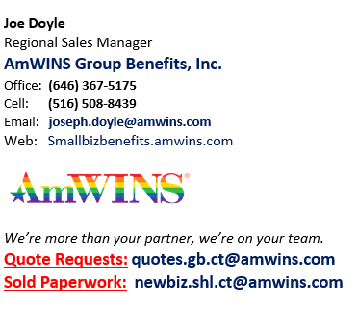
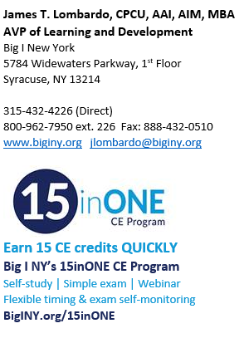
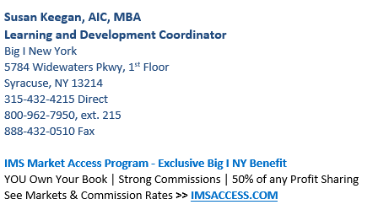
Thank You

